Slide 1

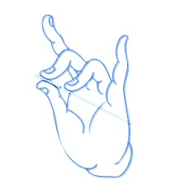
长白山通经调脏特色针法与应用（二）
Characteristics and Techniques of Diagnosis and Treatment of Changbai Mountain
主讲人：王富春 教授
Speaker: Professor Wang Fuchun

Slide 2
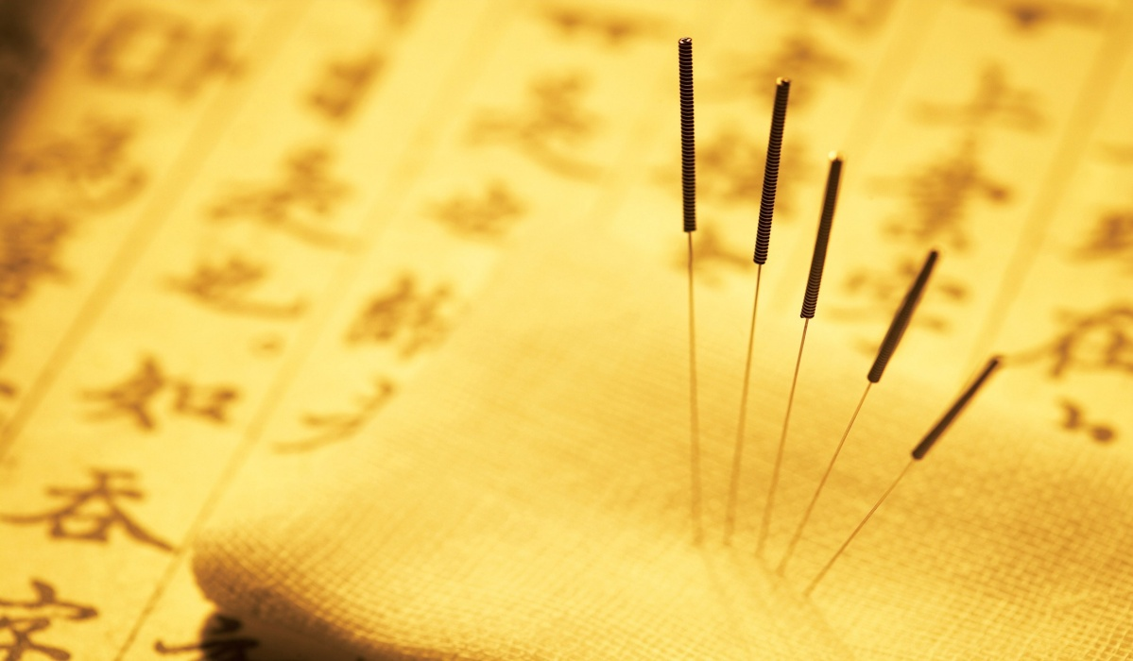
目录
Contents
1
醒神益气针法
The acupuncture therapy of promoting resuscitation and tonifying qi
2
多针浅刺针法
Multiple shallow acupuncture
3
补虚化瘀针法
Acupuncture for tonifying deficiency and removing stasis

Slide 3
1
醒神益气针法
The acupuncture therapy of promoting resuscitation and tonifying qi

Slide 4
理论来源
Theoretical sources

Slide 5
理论来源
中风偏瘫
Theoretical sources
Stroke hemiplegia
现代医学认为，由脑部血液循环障碍引起的急性脑功能损伤后除意识恢复清醒外，仍存有不同轻重的肢体运动障碍，称为中风后遗偏瘫。
Modern medicine believes that there are still different degrees of limb movement disorders after acute brain function injury caused by disturbance of blood circulation, which is called hemiplegia after stroke.

Slide 6
理论来源
病因病机
etiology and pathogenesis
Theoretical sources
由于脏腑功能失调，元气亏虚或痰浊、瘀血内生，加之饮食内伤、七情失常等外因，导致脑神经痹阻或血溢脉外，引发中风，造成肢体瘀血阻滞，络脉不通。
Apoplexy results from the blocked cranial nerves or the overflowed blood which due to the dysfunction of viscera, deficiency of vital energy or phlegm, blood stasis, internal injury of diet, disorder of seven emotions and other external factors,and then they cause blood stasis block of limbs and meridians impassability.
病位：在脑
Location of disease:brain
与心、肾、肝、脾密切相关
it is closely related to heart, kidney, liver and spleen.

Slide 7
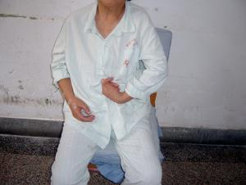
理论来源
Theoretical sources
临床表现
Clinical manifestation
一侧肢体肌力减退、活动不利
同侧肢体的感觉障碍
同侧的视野缺损
Muscle strength of one limb is decreased and activity is not good
Sensory disturbance of ipsilateral limbs
Ipsilateral visual field defect

Slide 8
理论来源
Theoretical sources
久病气血亏损
劳倦内伤
weakness of Qi and blood due to long illness
fatigue and internal injury
病因认识
Pathogeny
七情所伤
脾失健运
emotional disorders
failure of the spleen in function

Slide 9
理论来源
Theoretical sources
久病气血亏虚
weakness of Qi and blood due to long illness
Deficiency of Qi results in weakness of blood circulation and poor blood flow, which leads to stagnation of cerebral blood vessels; deficiency of yin and blood results in imbalance of yin and Yang. The internal wind moves more and more, carrying phlegm and blood stasis to disturb the brain, causing this disease.
As "jingyuequanshu · feifeng" said: "Fall down in a faint is all internal injuries and frequently strain."
气虚则运血无力，血流不畅，而致脑脉瘀滞不通；阴血亏虚则阴不制阳，内风动越，携痰浊、瘀血上扰清窍，突发本病。
正如《景岳全书·非风》说：“卒倒多由昏愦，本皆内伤积损颓败而然。”

Slide 10

劳倦所伤
理论来源
Theoretical sources
劳倦内伤烦劳过度，伤耗阴精，阴虚而火旺，或阴不制阳易使阳气虚浮，引动风阳，内风旋动，则气火俱浮，或兼挟痰浊、瘀血上壅清窍脉络。
Fatigue and internal injury may cause the imbalance of Yin and Yang.Yin deficiency so fire flourishing,or Yin can not fight Yang.It is easy to make Yang Qi floating.The internal wind whirling,Qi and fire all floating,carrying turbid phlegm,blood stasis to block meridians.
fatigue and internal injury

Slide 11
理论来源
Theoretical sources
脾失健运
脾失健运过食肥甘醇酒，致使脾胃受伤，脾失运化，痰浊内生，郁久化热，痰热互结，壅滞经脉，上蒙清窍；或素体肝旺，气机郁结，克伐脾土，痰浊内生；或肝郁化火，炼津成痰，痰郁互结，携风阳之邪，窜扰经脉，发为本病。
failure of the spleen in function
Plus wine Feigan overeating causes the malfunction of spleen,resulting in spleen and stomach dysfunction.Failure of the spleen in function, and then phlegm is turbid.Phlegm and heat are combined with each other and block meridians.On the one hand, if a person usually feels so angry that Qi is not working.That can influence the function of spleen, so phlegm is turbid and endogenous.On the other hand, if a person always feels depression and the fire is transformed.Phlegm is refined and formed, phlegm and depression are combined with each other, carrying the evil of wind and Yang, disturbing meridians, and causing the disease.

Slide 12
理论来源
Theoretical sources
脾失健运
《丹溪心法·中风》所谓“湿土生痰，痰生热，热生风也”。饮食不节，脾失健运，气血生化无源，气血精微衰少，脑脉失养，再加之情志过极、劳倦过度等诱因，使气血逆乱，脑之神明不用，而发为中风。
failure of the spleen in function
As Danxi Xinfa·Stroke said:"Dampness makes phlegm, phlegm makes heat, heat makes wind."There are some elements lead to stroke,such as improper diet, failure of the spleen in function, passive biochemistry of Qi and blood, the decline of essence of Qi and blood, and lack of nutrient substance of brain vessels, as well as excessive emotion and tiredness, the Qi and blood are in disorder, and the brain is not work.

Slide 13
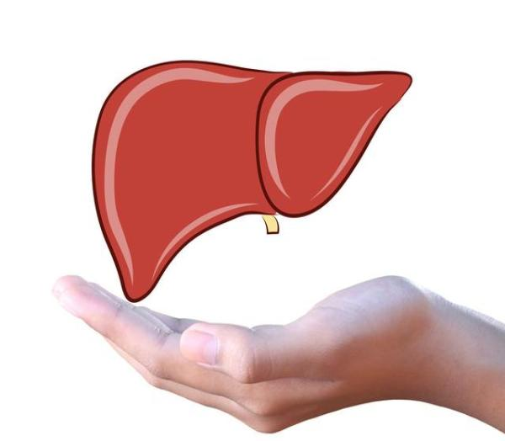
理论来源
Theoretical sources
情志过极七情所伤，肝失条达，气机郁滞，血行不畅，瘀结脑脉；暴怒伤肝，则肝阳暴张，或心火暴盛，风火相煽，血随气逆，上冲犯脑。凡此种种，均易引起气血逆乱，上扰脑窍而发为中风。尤以暴怒引发本病者最为多见。
情志所伤
emotional disorders
When someone has excessive emotion, the liver is out of order, the Qi is stagnant, the blood flow is not smooth, and the brain vessels are stagnated.When the liver is injured by rage, the liver Yang is distended, or the heart is violent, the wind and fire are together, and the blood goes with the Qi and attack the brain. All of these species are easy to cause Qi and blood disorder, and then cause a stroke. Especially the anger caused by this disease is the most common.

Slide 14
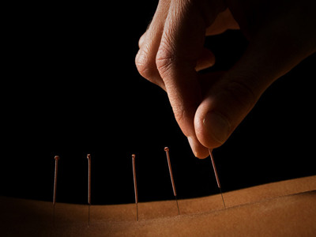
醒神益气针法
acupuncture therapy of refreshing the spirit and ivigorating the spirit
醒神益气针法——长白山流派传人总结多年临床治疗经验。
The descendants of Changbai Mountain School have summarized many years of clinical treatment experience—Acupuncture Therapy of refreshing the spirit and ivigorating the spirit

Slide 15
理论来源
天
upper part
Theoretical sources
百会
Baihui
腧穴选择
Acupoint selection
地
内关
足三里
人
middle part
Neiguan
Zusanli
lower part
取百会醒神之功
足三里益气之效
内关理气降逆之用
take Baihui to refresh the spirit
take Neiguan to regulate Qi and reduce reversed flow of Qi
take Zusanli to ivigorate Qi

Slide 16
理论来源
循经取穴
Theoretical sources
Acupoint selection along meridians
天有
三宝
百会为经外奇穴，属于督脉,是督脉、足太阳膀胱经、手少阳三焦经、足少阳胆经、足厥阴肝经等五条经脉的交会处。
Baihui is a special point for the extraordinary points, belonging to the Du Meridian. It is the intersection of the five meridians.They are the Du Meridian, the Bladder meridian of foot-Taiyang, the Sanjiao meridian of hand-Shaoyang, the gallbladder meridian of foot-Shaoyang and the liver meridian of foot-Jueyin.
内关穴为手厥阴心包经之络,别走手少阳经,又与阴维脉脉气相同,是奇经八脉交会穴之一。益心安神,和胃降逆,宽胸理气,镇静止痛之功效。
Neiguan acupoint is the collateral point of pericardium meridians of hand-Jueyin. It is one of the eight channels intersection acupoints. It has the effect of benefiting the heart and calming the mind, reducing the adverse effects of stomach, widening the chest and regulating Qi, calming and relieving pain.
足三里穴为胃经之合穴,具有理脾胃、调气血、补虚弱、宣畅气机诸多功效。
Zusanli is the he-sea point of the stomach meridian, which has many functions such as regulating the spleen and stomach, regulating the Qi and blood, supplementing the weak and weakening the air machine.

Slide 17

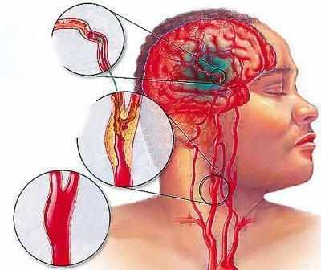
理论来源
穴位选择
Theoretical sources
Acupoint selection
天有
三宝
百会穴与脑密切联系,是调节大脑功能的要穴。《会元针灸学》说:“百会者,五脏六腑奇经三阳,百脉之所会”。
穴性属阳,又于阳中寓阴,故能通达阴阳脉络,连贯周身经穴。对于调节机体的阴阳平衡起着重要作用。百会更具醒脑开窍的作用。
Baihui Point is closely related to the brain and is an important point for regulating brain function."Huiyuan Acupuncture and Moxibustion" said: "The Baihui is a intersection of the five internal organs,the three Yang meridians and the hundred veins."
The acupoint is yang, and it is in the yang of the yin, so it can reach the yin and yang veins, and coherent to the body. It plays an important role in regulating the balance of yin and yang of the body. Baihui is more refreshing.

Slide 18

理论来源
穴位选择
Theoretical sources
Acupoint selection
足三里穴
“治萎独取阳明”,足三里穴是足阳明胃经之合穴,“胃者五脏六腑之海也。水谷皆入于胃,五脏六腑之气皆禀于胃”,胃为水谷之海,可包容五谷,荣养四旁。又脾胃互为表里,为后天之本,气血生化之源,是机体生命活动的基础。足三里穴为胃经之要穴,具有理脾胃、调气血、补虚弱、宣畅气机等诸多功效而倍受关注。
天有
三宝
Zusanli point
“Treatment for flaccidity aims at Yangming meridian.”Zusanli is the he-sea point of the stomach meridian.”The stomach is the sea of the internal organs. Essential substances from water and cereals are all in the stomach, and the qi that supports the internal organs is from the stomach.”The spleen and stomach are the same in the table, which is the basis for future growth and development. They are the source of qi and blood and the basis of the life activities.A lot of people pay attention to Zusanli because it is the important point of the stomach meridian, which has many functions such as regulating the spleen and stomach, regulating the Qi and blood, supplementing the weak and weakening the air machine and so on.

Slide 19
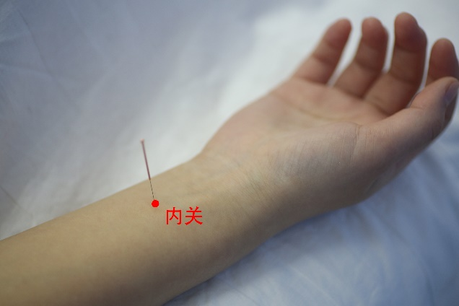
理论来源
穴位选择
Theoretical sources
Acupoint selection
天有
三宝
内关穴为手厥阴心包经之络,别走手少阳经,又与阴维脉脉气相同,是奇经八脉交会穴之一。益心安神,和胃降逆,宽胸理气,镇静止痛。
Neiguan acupoint is the collateral point of pericardium meridians of hand-Jueyin. It is one of the eight channels intersection acupoints. It has the effect of benefiting the heart and calming the mind, reducing the adverse effects of stomach, widening the chest and regulating Qi, calming and relieving pain.

Slide 20
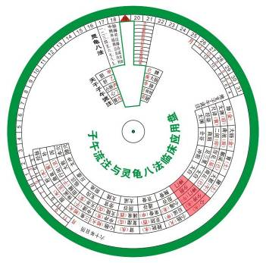
理论来源
Theoretical sources
治疗时机
Treatment timing
本法针刺以取未时（下午13-15时）为宜
使在阳盛之时更助其功，
调动气血，助阳活血
同时重视调神。
百会，百病皆主
This method is suitable for taking acupuncture at 13 to 15 pm.
Make it more helpful at the time of Yang excessiveness.It can transfer blood, help yang and promote blood circulation
At the same time, we should pay attention to regulating the spirit.Baihui is applicable to all diseases.

Slide 21
临床应用
Clinical Application

Slide 22
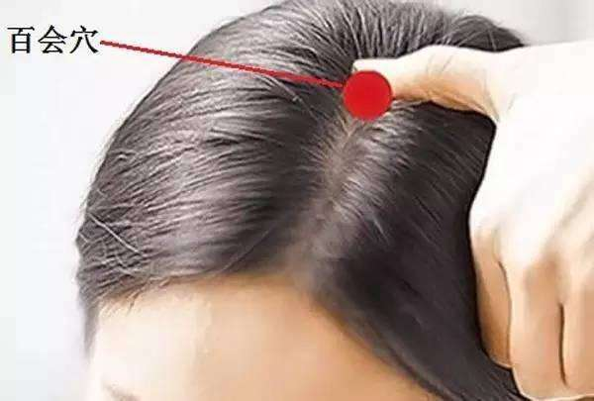
临床应用
Clinical Application
操作
醒神益气法主要用于中风偏瘫的治疗，取百会、内关、足三里，语言不利配廉泉、地仓；上肢不遂配曲池、合谷；下肢不遂配阳陵泉、悬钟。
operation
The method of refreshing the spirit is mainly used in the treatment of apoplectic hemiplegia.We mainly Select Baihui,Neiguan and Zusanli,cooperating with Lianquan and Dicang can treat aphasia,cooperating with Quchi and Hegu can treat upper limb paralysis,cooperating with Yinlingquan and Xuanzhong can treat lower limb paralysis.

Slide 23
临床应用
Clinical Application
百会位于后发际正中直上7寸，或当头部正中线与两耳尖连线的中点。浅刺至天部，顺其经脉循行方向针刺，平刺0.5-0.8寸，行针手法以小幅度、快频率捻转为主，力求获得沉、重、下压的得气感觉，以达醒脑调神导气之效。
操作
operation
Baihui is located 7 inches straight in the middle of the hairline, or the center line of the head with the two ear tips.Baihui needs a shallow thruet and following the direction of Du meridians.Horizontal insertion of needle reaches to 0.5-0.8 inch.The needling manipulation is mainly based on small amplitude and fast frequency and aims to get the feeling of sinking, heavy, and pressing down to achieve the effect of refreshing the spirit and regulating the spirit.

Slide 24
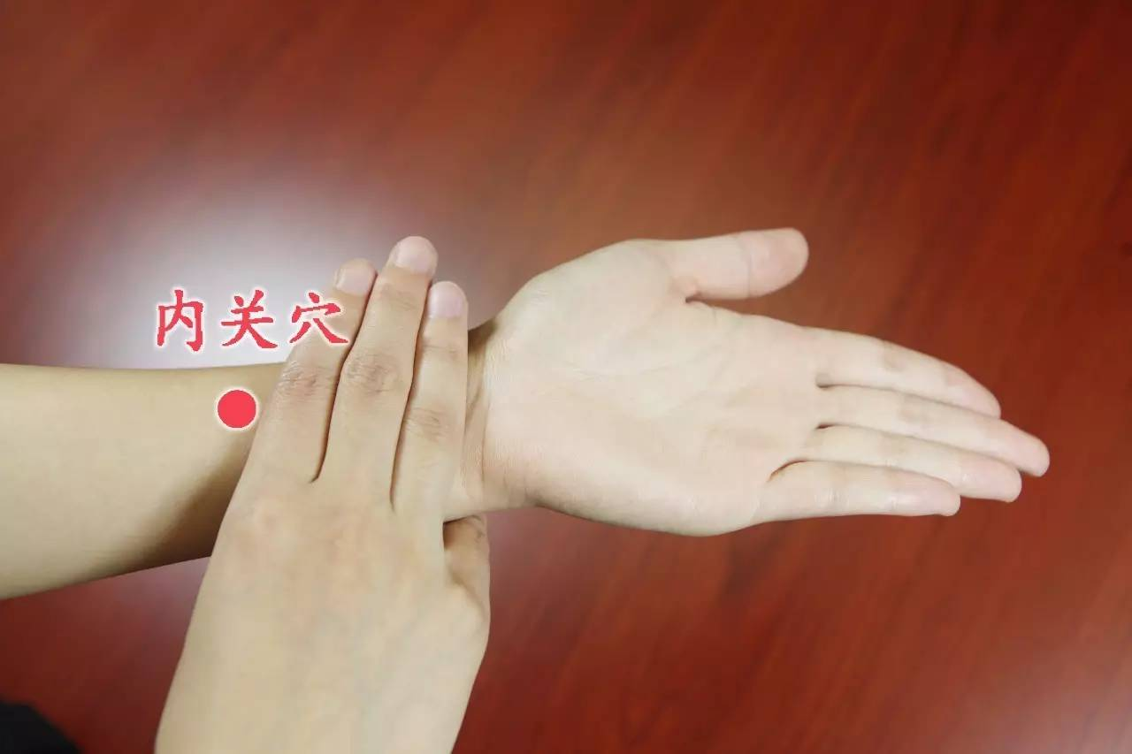
临床应用
clinical application
内关：腕横纹上两寸，掌长肌腱与桡侧腕屈肌腱之间，直刺0.5-1寸。
Neiguan Location: 2 inches on the wrist transverse line, between the palmaris longus tendon and the flexor carpi radialis tendon.
Perpendicular insertion of needle reaches to 0.5-1 inch.
注：内关：手法以小幅度、快频率捻转为主的泻法，具有和胃降逆，宽胸理气的功效。
Note:The needling manipulation is mainly based on small amplitude and slow frequency rotation of the needle handle.It has the effect of reducing the adverse effects of stomach, widening the chest and regulating Qi.

Slide 25
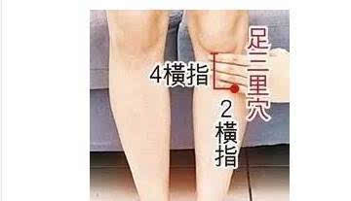
临床应用
clinical application
足三里位于犊鼻下3寸，胫骨前嵴外1横指处。
直刺0.5-1寸。
Zusanli Location: 3 inches under the Dubi,1 horizontal finger outside the front of the shin bone.
Perpendicular insertion of needle reaches to 0.5-1 inch.
注：足三里：手法以小幅度、慢频率捻转为主的补法，具有理脾胃、调气血、宣畅气机等功效。
Note:The needling manipulation is mainly based on small amplitude and slow frequency rotation of the needle handle.It has the effect of regulating the spleen and stomach, regulating the Qi and blood, supplementing the weak and weakening the air machine and so on.

Slide 26
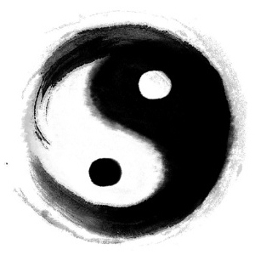
疗效标准
临床应用
Efficacy standard
clinical application
4.1 语言功能 正常0分;一般表达,命名不能1分;说话成句而表达不全2分;不能说单词、词组3分;语言不能或基本不能4分。
4.2 上肢肩关节 正常0分;上举不全而肌力差1分;上举平肩或略过肩2分;上举不到肩3分;前不能动或后略摆4分。
4.3 上肢指关节 正常0分;手指分别动作有效或肌力差1分;握拳伸指2分;屈指、握不成拳、不会伸3分;不会动4分。
4.1 Speaking Ability
0 point: normal;1 point:general expression, naming cannot be;2 point:speak into a sentence but express it incomplete;3 point:can't say words, phrases; 4 point:can not speak or basically can't.
4.2 Upper limb and shoulder
0 point: normal; 1 point:incomplete lifting and poor muscle strength; 2 point:to raise horizontally or slightly above the shoulder; 3 point:can't lift up to shoulder level; 4 point:unable to move forward or swing back slightly.
4.3 Upper limb and knuckle
0 point:normal; 1 point:finger action is effective or muscle strength is poor;2 point:clenching fist and extending fingers;3 point:fingers curled,can't clench fist and can't extend fingers; 4 point: will not move.

Slide 27
疗效标准
临床应用
Efficacy standard
clinical application
4.4 下肢髋关节 正常0分;抬高45°以上1分;抬高不足45°者2分;摆动能平移3分;不能动4分。
4.5 下肢趾关节 正常0分;伸屈自如、力弱1分;伸屈不全2分;略动3分;不会动4分。
4.6 综合功能 生活能自理,自由交谈0分;独立生活简单劳动而部分功能不全1分;可行走,部分自理,尚需人辅助2分;可行走,需要人随时照料3分;卧床4分。
4.4 Lower limb and Hip joint
0 point: normal; 1 point:raising above 45°; 2 point:raising less than 45°; 3 point:can move horizontally; 4 point:will not move.
4.5 Lower limb and Toe joint
0 point: normal; 1 point:stretch and bend freely,but muscle strength is poor; 2 point:can not stretch and bend freely; 3 point:slightly moving; 4 point:will not move.
4.6 Comprehensive function
0 point: can self-care and talking freely; 1 point: independent life, doing simple work and partial function; 2 point:walkable, partially self-care, and still need assistance; 3 point: walkable but need people to take care of at any time; 4 point: bedridden.

Slide 28
临床应用
clinical application
疗效评定
Curative effect evaluation
Essentially recovered.: ≥ 85%;
Markedly effective: ≥ 50%,< 85%;
Effective: ≥ 20%, < 50%;
Invalid: < 20%。
Treatment outcome：
3 cases recovered,15 cases markedly effective,11 cases effective ,1 case Invalid ,The total effective rate is 96.7%.
基本痊愈: ≥ 85%;
显效: ≥ 50%,< 85%;
有效: ≥ 20%, < 50%;
无效: < 20%。
治疗结果：痊愈3例,显效15例,有效11例,无效1例,总有效率达96.7%。

Slide 29
病案分析
Case Analysis

Slide 30
病案分析
Medical Record Analysis
天有
三宝
王某，女，59岁。
主诉：右侧肢体活动不利14年，复发加重伴眩晕20天。
现症：患者于入院前 14年前因“脑出血”而出现右侧肢体活动不利，经治疗后症状缓解，20天前, 在无明显诱因突然出现右侧肢体活动不利加重并伴眩晕呕吐，站立不稳，站立时，向患侧倾倒。发作时不伴头痛，不伴有意识障碍。右侧肢体活动不利，浅感觉减退，语声不晰，二便可，纳眠可，舌淡红，苔厚腻，脉滑。
Wang,female,59 years old.
Chief complaint:The right side of the limbs was unfavorable for 14 years, and the recurrence was aggravated with vertigo for 20 days.
Current medical history:The patient's right side limb activity was unfavorable due to "cerebral hemorrhage" 14 years before admission, and the symptoms were relieved after treatment.20 days ago, in the absence of obvious incentives, the right side of the limbs was unfavorably aggravated with vertigo and vomiting. Standing unstable, when standing, dumped to the affected side. There is no headache at the time of attack, and no conscious disturbance. The right side of the limbs is unfavorable, the shallow feelings are diminished, and the voice is not clear.Bowel movements and sleep are normal.Pale tongue, thick fur,the pulse is slippery.

Slide 31
病案分析
Medical Record Analysis
天有
三宝
既往史：有糖尿病史，服用降糖药，否认食物及药物过敏史。否认乙肝等传染病病史。
辅助检查： CT示：左侧顶叶双侧半卵圆窝中心、双侧基底节区、 左侧大脑脚、桥脑多发缺血性腔梗灶。双侧室旁白质脱髓鞘改变，脑萎缩。
Past history:Have a history of diabetes, taking hypoglycemic drugs.Denied the history of food and drug allergies. Denied the history of infectious diseases such as hepatitis B.
Supplementary Examination:CT shows:The left parietal lobe of the bilateral semi-ovate fossa, bilateral basal ganglia, left cerebral peduncle, and cerebral cerebral ischemic luminal infarction. Bilateral ventricular white matter demyelination changes, brain atrophy.

Slide 32
病案分析
Medical Record Analysis
天有
三宝
诊断：西医诊断：：脑梗塞后遗症
中医诊断：中风——气虚血滞，脉络瘀阻
治疗方案：针灸治疗，日一次，7次1疗程，取穴如下：
百会、肩髃、曲池、外关、内关、合谷、环跳、阳陵泉、足三里（双）、昆仑，
治疗2疗程后，肌力提高，眩晕症状明显改善，右侧肢体力量提高，站立时间延长。
Diagnosis: Western medicine diagnosis:Cerebral infarction sequelae
TCM diagnosis: Stroke——Qi deficiency and blood stasis
Treatment plan:acupuncture treatment, once a day, 7 times a course of treatment, acupoints are as follows:
Baihui,Jianyu,Quchi,Waiguan,Neiguan,Hegu,Huantiao,Yanglingquan,Zusanli(double),Kunlun.
After 2 courses of treatment, the muscle strength is improved, the symptoms of vertigo are obviously improved, the strength of the right limb is improved, and the standing time is prolonged.

Slide 33
病案分析
Medical Record Analysis
天有
三宝
陈某，男，52岁。
主诉：左侧肢体活动不便1年余。
现症：1年前患者早晨起床后发现左侧肢体活动不便，语言不利，但无头疼、头晕症.现患者右侧肢体活动不便，纳可，眠可，二便尚能自理。
既往史：既往体健；无“高血压、糖尿病、心脏病”病史；否认有“肝炎等传染病史。
辅助检查：记忆力，计算力正常，定向力可，左上肢肌力 4 级、左下肢肌力4 级，右巴氏征（+）。
Chen, male, 52 years old.
Chief Complaint:The left side of the limbs is inconvenient for more than 1 year.
Current medical history:One year ago, when the patient got up in the morning, he found that the left side of the limb was inconvenient, and the talking was unfavorable, but there was no headache or dizziness.Eating,sleeping and bowel movements are normal.
Past history:He was healthy in the past.No history of "hypertension, diabetes, heart disease".Denied the history of infectious diseases such as hepatitis.
Supplementary Examination:Memory and computing power are normal.The left upper limb muscle strength 4, left lower limb muscle strength 4, right Babinskin sign (+).

Slide 34
病案分析
Medical Record Analysis
天有
三宝
诊断：西医诊断：脑梗塞后遗症
中医诊断：中风—浊痰阻络型
治疗方案：针灸治疗，日一次，7次1疗程，取穴如下：
百会、内关、足三里（双）、肩髃、曲池、外关、合谷、环跳、阳陵泉
治疗2疗程后，患者语言功能出现改善，需进一步治疗。左肢肌力提高，头脑清明，站立时间延长。
Diagnosis: Western medicine diagnosis:Cerebral infarction sequelae
TCM diagnosis: Stroke——Turbid phlegm Blocking meridians
Treatment plan:acupuncture treatment, once a day, 7 times a course of treatment, acupoints are as follows:Baihui,Neiguan,Zusanli(double),Jianyu,Quchi,Waiguan,Hegu,Huantiao,Yanglingquan.
After 2 courses of treatment, the patient's language function improved and further treatment was needed. The muscle strength of the left limb is improved, the mind is clear, and the standing time is prolonged.

Slide 35
病案分析
Medical Record Analysis
天有
三宝
刘某，男，50岁。
主诉： 右侧肢体活动不利2月。
现症：患者于2月前无明显诱因感右侧肢体活动不利， 伴头晕，无视物旋转，现仍有右侧肢体活动不利，刻下未闻及咳嗽、呕吐、呃逆等各种声响，未闻及异常异味，腰酸腿软，眩晕耳鸣，舌质暗红,苔薄白，边有齿痕，脉弦滑。无恶心呕吐，
既往史：高血压病史10余年。无吸烟史。否认肝炎、结核等传染病史。
辅助检查：头颅 CT示：脑干、右侧丘脑、双侧基底节及左侧小脑梗塞灶及软化灶。
Liu, male, 50 years old.
Chief Complaint:Physical activity on the right side is unfavorable for 2 months.
Current medical history:The patient had no obvious incentive to the unfavorable of physical activity on the right side before 2 months, accompanied by dizziness, no blurred vision, and there were still unfavorable activities on the right side of the limbs. There were not heard various sounds such as cough, vomiting, hiccups, etc., and no abnormal smell. Backache, weakness of both legs, dizziness, tinnitus, dark red tongue, thin white fur, tooth marks on the sides of tongue, slippery pulse. No nausea or vomiting.
Past history:History of hypertension for more than 10 years.No smoking history. Denied the history of infectious diseases such as hepatitis and tuberculosis.
Supplementary Examination:Head CT shows:Brain stem, right thalamus, bilateral basal ganglia and left cerebellar infarction and softening.

Slide 36
病案分析
Medical Record Analysis
天有
三宝
诊断：西医诊断：脑梗塞后遗症
中医诊断：中风—肾虚精亏型
治疗方案：针灸治疗，日一次，7次1疗程，取穴如下：
百会、内关、肩髃、曲池、足三里（双）、外关、解溪、太冲、阳陵泉
治疗1疗程后，患者腰膝酸软症状改善，头晕减轻，右侧肢体力量提高，需加强治疗，恢复良好。
Diagnosis: Western medicine diagnosis:Cerebral infarction sequelae
TCM diagnosis: Stroke——Kidney deficiency
Treatment plan:acupuncture treatment, once a day, 7 times a course of treatment, acupoints are as follows:
Baihui,Neiguan, Jianyu,Quchi,Zusanli(double),Waiguan,Jiexi,Taichong,Yanglingquan.
After 1 course of treatment, the patient's symptoms are improved, the dizziness is relieved, and the right limb strength is improved. It is necessary to strengthen the treatment and will recover well.

Slide 37
2
多针浅刺针法
Multiple shallow acupuncture

Slide 38
理论来源
Theoretical Sources

Slide 39
理论来源
Theoretical sources
何为多针浅刺
多针浅刺，就是在毫针浅刺的基础上，取穴较其它疗法相对较多的一种针刺治疗方法，是针刺治疗某些疾病初起的主要疗法。
Multi-needle shallow needling is a kind of acupuncture treatment method with more acupoints than other treatments on the basis of filiform needle shallow needling, and it is the main treatment for the initial treatment of some diseases.

Slide 40
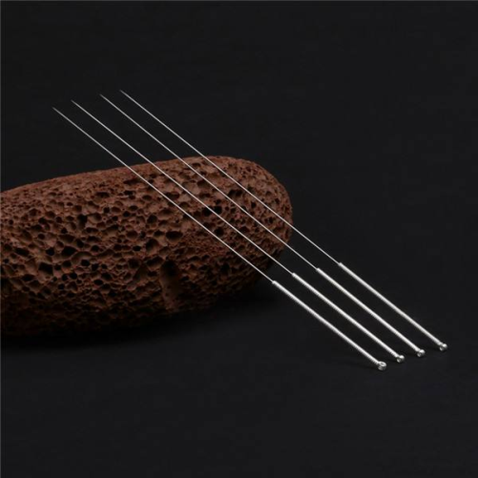
理论来源
Theoretical sources
古代阐述
浅刺法，也就是《灵枢·官针》所述毛刺、半刺、浮刺等刺法。
《灵枢·逆顺肥瘦》说：“刺此者，以毫针浅刺而疾发针”。
Shallow stab method is also referred in Miraculous Pivot · Guan Zhen, such as burr, half stab and floating stab.
Miraculous Pivot · Ni Fei Shun Shou says, the person who pricks this needle will stab it lightly with a filiform needle and shoot it quickly.

Slide 41
理论来源
Theoretical sources
《素问·刺要论》说：“病有浮沉，刺有浅深，各至其理，无过其道。”明代杨继洲说：“百病初起，皆起于荣卫，然后淫于皮肉筋脉，是以刺法中但举荣卫，盖取荣卫顺逆则皮骨筋肉之治在其中矣。以此思之，至于部分有深浅之不同，却要下针无过不及为妙”。
Plain Questions · On Fundamentals of Acupuncture says, there are ups and downs, and there are shallow and deep thorns. Said Yang jizhou of the Ming dynasty, "all diseases started from rongwei, and then they all started from rongwei. With this thought, as for the part of the depth of the different, but under the needle has not been better than.
古代阐述

Slide 42
理论来源
Theoretical sources
长白山通经调脏流派根据中医经典理论和自己多年的临床工作经验将浅刺法分为接经浅刺法、局部浅刺法和围针浅刺法，从而形成了多针浅刺的特殊针刺治疗方法，此法取得了良好的临床疗效。
According to the classical theory of traditional Chinese medicine and his clinical experience for many years, professor wang fuchun divides shallow acupuncture into shallow acupuncture by connecting the channels, local shallow acupuncture and peripheral acupuncture.

Slide 43
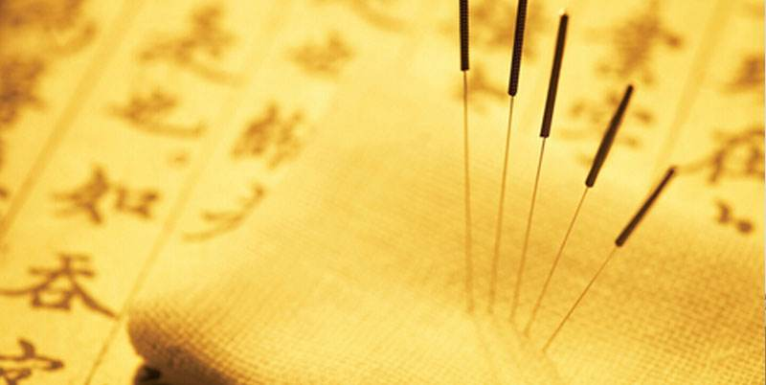
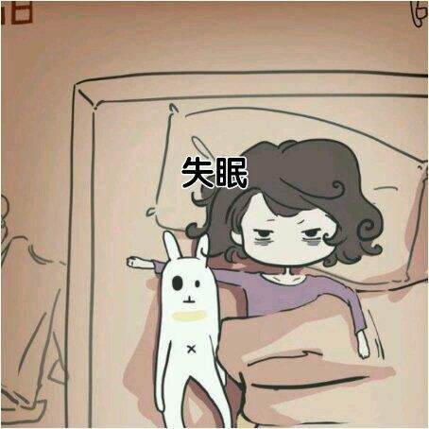
理论来源
Theoretical sources
分类
接经浅刺法
局部浅刺法
围针浅刺法
Transversely shallow
stabbing
Shallow local stabbing
Ring needle shallow
stab

Slide 44
理论来源
Theoretical sources
接经浅刺——主要是循经脉循行进行多针浅刺的方法，用于小儿脑瘫的治疗，针刺治疗以醒脑开窍、健脑益智、活血化瘀、疏通经络为取穴原则，以督脉和膀胱经第一侧线为主，针刺以督脉为主。
Connected with superficial acupuncture -- mainly the method of multiple needle shallow acupuncture along the meridians, which is used for the treatment of cerebral palsy in children. Acupuncture is based on the principle of acupoint selection to wake up the brain and open up the orifices, strengthen the brain and wisdom, promote blood circulation and remove stasis, and dredge the meridians. It is mainly focused on the du mai and the first lateral line of the bladder meridian, while acupuncture is mainly focused on the du mai.

Slide 45
理论来源
Theoretical sources
局部浅刺——多用于面瘫的治疗，面瘫多由络脉空虚，风寒或风热之邪乘虚侵袭面部筋脉，以致气血阻滞，肌肉纵缓不收而成。针刺多以局部经穴为主。面瘫患者初起，邪尚客于表，未曾入里，故治疗时宜浅刺，引邪消散。
Local shallow thorn - used for the treatment of facial paralysis, facial paralysis is mostly by the complex empty, wind cold or wind heat of the evil spirit to invade the face veins, so that qi and blood block, longitudinal slow muscle but not closed. Acupuncture mainly focuses on local meridians and acupoints. Facial paralysis patients at the beginning of the evil is still guests in the table, not into, it is time to treat shallow thorn, lead the evil dissipation.

Slide 46
理论来源
Theoretical sources
围针浅刺——是指以病变部位为中心，在其周围进行浅针围剌的方法。皮肤病多由于局部气血不通，经络阻滞所致，围针可起到疏风泄热，宣通局部气血的作用，使经脉畅通，肌肤得荣，为治疗皮肤病之佳法。
Circumferential needle shallow thorn -- it is to point to take pathological change place as the center, carry on shallow needle circumferential thorn in its periphery method. Skin disease as a result of local blood and gas imperforate much, meridian block is caused by, encircle needle can have sparse wind to drain heat, xuantong local blood and gas action, make meridian unimpeded, skin gets rong, it is the good method that treats skin disease.

Slide 47
临床应用
Clinical Application

Slide 48
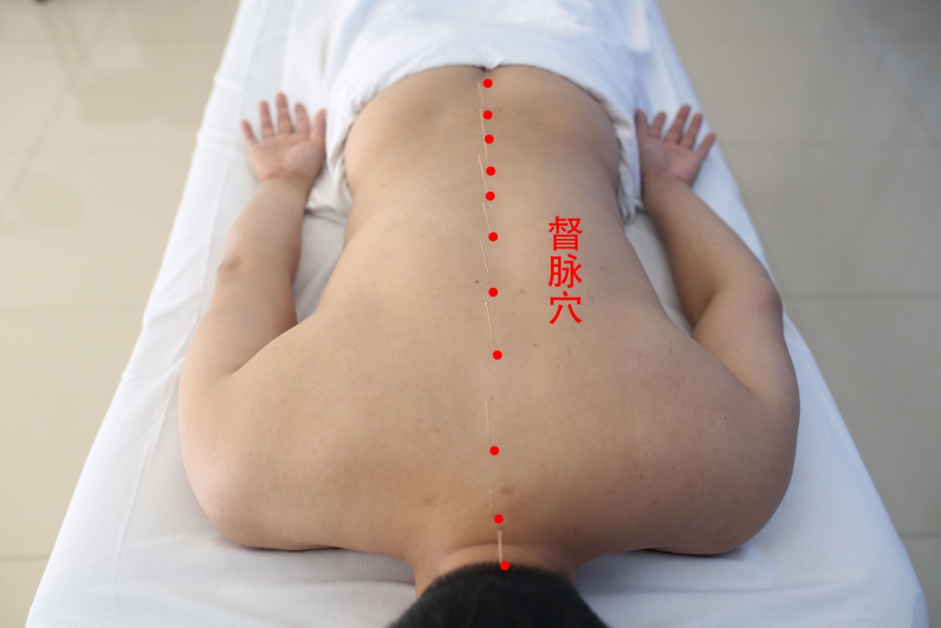
临床应用Clinical Application
1. 接 经 浅 刺 法 治 疗 脑 瘫
取穴
以督脉和膀胱经第一侧线上的经穴为主，取督脉的哑门、大椎、陶道、身柱、神道、灵台、至阳、筋缩、中枢、脊中、命门、腰阳关等穴位；
Acupuncture points on the first line of the Du meridian and the bladder meridian are mainly used to take the dumb door, dazhui, taodao, shenzhu,shendao, lingtai, zhiyang, jinsuo, zhongshu, jizhong, mingmen, yaoyangguan and other acupuncture points of the Du meridian.

Slide 49
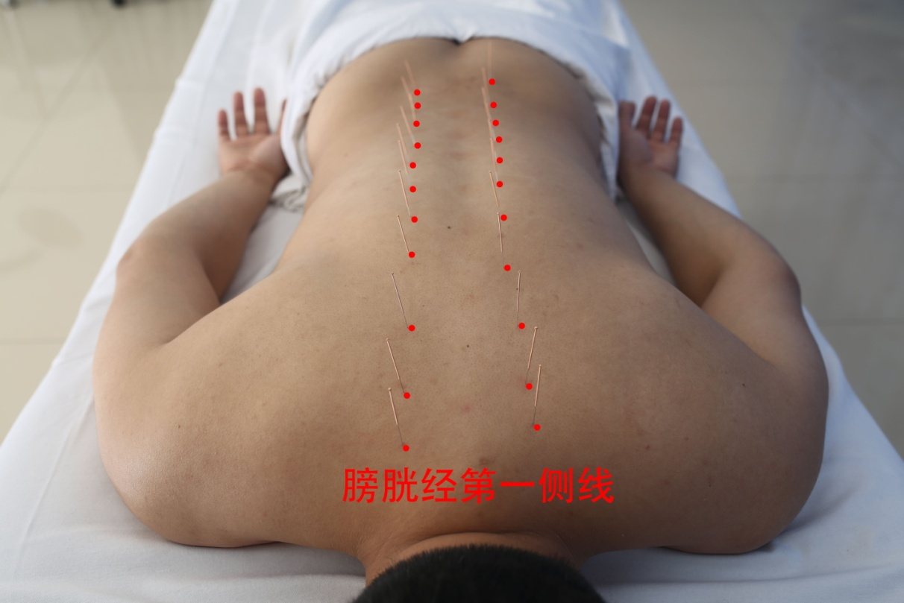
临床应用
Clinical Application
取穴
取膀胱经的大杼、风门、肺俞、厥阴俞、心俞、督俞、膈俞、肝俞、胆俞、脾俞、胃俞、三焦俞、肾俞等穴位。
The acupoints of dazhu, fengmen, feishu, jueyin shu, xinshu, dushu, geshu, ganshu, danshu, pishu, weishu, sanjiaoshu, shenshu and so on in the bladder meridian were taken.

Slide 50
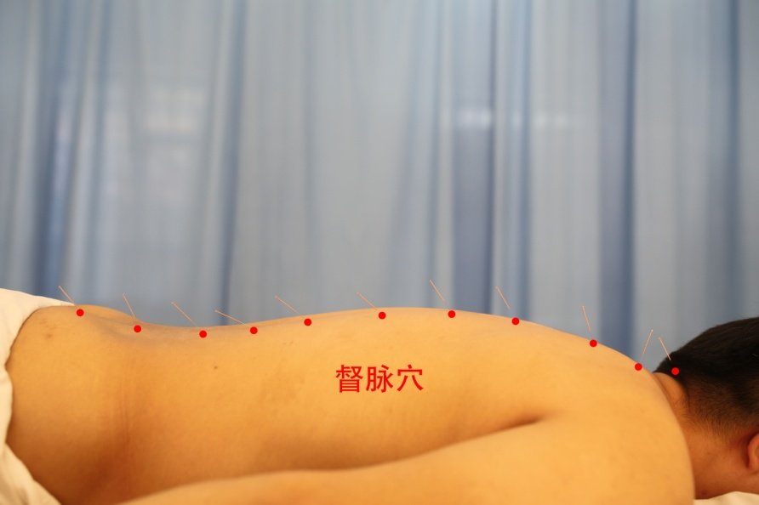
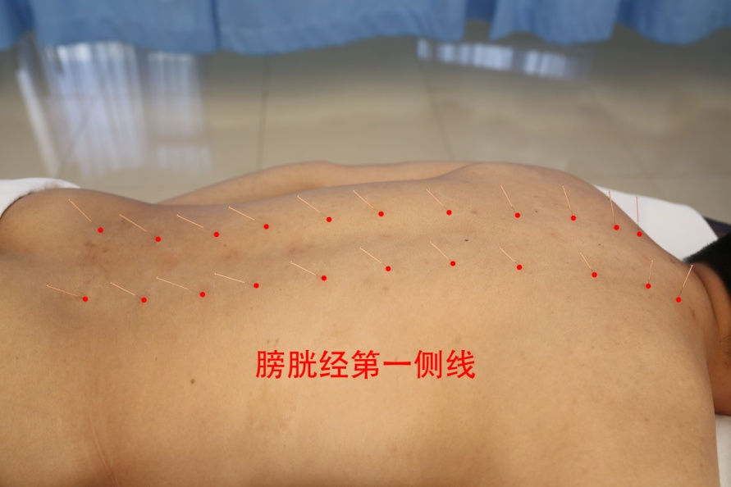
临床应用
Clinical Application
操作
操作者双手消毒，穴位消毒。消毒后，进针深度约2-3分，快速捻转10余次，马上出针，出针后，用棉球按压针孔。隔日1次。经针刺治疗30次后，右上肢明显较前灵活，剪刀腿基本纠正，能站立并扶着行走，不仅能说单词，而且能讲一些简单句。
The operator disinfects both hands, acupoint disinfection. After disinfection, the depth of the needle is about 2-3 minutes, and the needle is immediately released after twisting for more than 10 times. After the needle is released, the needle hole is pressed with a cotton ball. Once every other day. After 30 times of acupuncture treatment, the right upper limb was significantly more flexible than before, and the scissors leg was basically corrected, able to stand up and walk with the help of hands, able to speak not only words, but also some simple sentences.

Slide 51
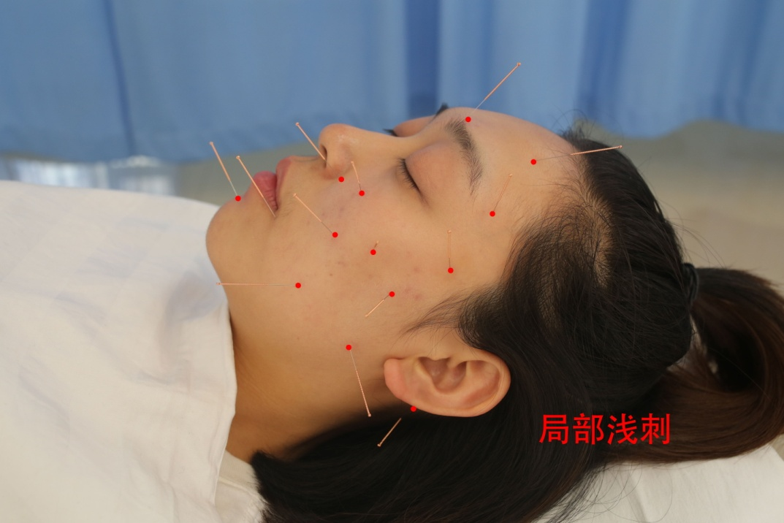
临床应用
Clinical Application
2. 局 部 浅 刺 法 治 疗 面 瘫
取穴
患者仰卧位，取穴翳风、下关、颊车、地仓、瞳子髎、阳白、太阳、攒竹、迎香、承浆、合谷等穴位。
Patients were maintained at supine position and selects acupoints such as yifeng, xiaguan, jiache, dicang, tongziliao, yangbai, taiyang, cuanzhu, yingxiang, chengjiang, hegu and so on.

Slide 52
临床应用
Clinical Application
操作者双手消毒，穴位消毒。消毒后，毫针局部浅刺法，快速捻转后留针30分钟，出针后，用棉球按压针孔。每日1次。针10次后，口角歪斜即纠正，闭眼、皱眉尚不够灵活。再针6次后痊愈。
The operator disinfects both hands. After disinfection, local shallow needling method of the millineedle was performed, and the needle was retained for 30 minutes after rapid rotation. After the needle was released, the needle hole was pressed with a cotton ball. Once a day. After needle 10 times, mouth Angle is askew correct namely, close an eye, frowning still is not enough agile. The patient recovered after 6 more injections.
操作

Slide 53
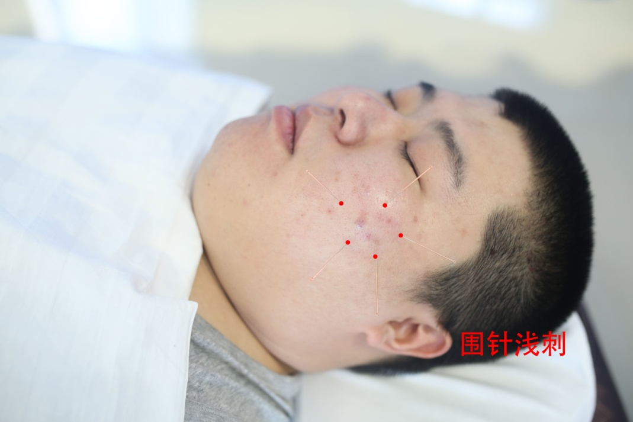
临床应用
Clinical Application
3. 围 针 浅 刺 法 治 疗 皮 肤 病
取穴
患者取仰卧位，取穴以病灶局部为中心，沿痤疮外缘进行围针，进行针刺即可。
Patients were maintained at supine position, with the focal point as the center, and acupuncture was performed along the outer edge of acne.

Slide 54
临床应用
Clinical Application
选用0.28mm×15mm美容针，以拇食指持针，在病灶周围正常皮肤处行多针围刺，针刺毫针数以将病灶包围为宜、针与针间可保持1cm左右距离。一般每侧4-5针，留针30分钟。每日治疗1次，10次1个疗程。
Select 0.28mm×15mm hairdressing needles, and the thumb and index finger were used to hold the needle, and multiple needles were used to surround the lesion at the normal skin around the lesion. It was advisable to surround the lesion with millineedles, and the distance between needles could be maintained about 1cm. Generally, 4-5 stitches are placed on each side, and the needles are left for 30 minutes. Treatment once a day, 10 times a course of treatment.
操作

Slide 55
病案分析
Case Analysis

Slide 56
病案分析
Case Analysis
刘某，男，5岁。
主诉：自出生起不能独立步行，加重两周。初诊：2018年10月3日。
现症： 不能独立步入病室，辅助下可以行走，但呈现剪刀步态，双膝屈曲，双足跟不能着地，五指呈屈曲状，语言迟钝表达不清。纳可，眠可，二便调。舌质淡暗，苔少，脉沉细。经多方就诊，疗效欠佳。后经介绍，前来我院针灸科门诊就诊。
Liu mou, male, 5 years old.
Chief complaint:unable to walk independently since birth, aggravating for two weeks. First visit: Oct. 3, 2018.
History of present illness:unable to walk independently into the sick room, able to walk with assistance, but with scissors gait, knees flexed, feet unable to land on the ground, five fingers flexed, slow and inarticulate language. Nac, mik, erba. Tongue light dark, moss less, pulse heavy fine. After multiple treatment, the curative effect is not good. After the introduction, came to our hospital acupuncture and moxibustion clinic.
天有
三宝

Slide 57
病案分析
Case Analysis
既往史：该患儿为早产儿，孕29周早产，出生时体重1.7千克。出生后运动智力发育与同龄儿童相比滞后。
辅助检查：头颅MRI：胼胝体发育不良伴多微脑回畸形。
History of past illness:the baby was born prematurely at 29 weeks of gestation and weighed 1.7kg at birth. After birth, motor intelligence development lags behind that of children of the same age.
Auxiliary examination: cranial MRI: corpus callosum dysplasia with multiple microgyrus deformity.
天有
三宝

Slide 58
病案分析
Case Analysis
天有
三宝
诊断：西医诊断：脑瘫
中医诊断：五迟—心脾两虚型
治疗方案：针灸治疗，日一次，7次1疗程，取穴如下：
取督脉穴：哑门、大椎、陶道、身柱、神道、灵台、至阳、筋缩、中枢、脊中、命门、腰阳关等穴位；
取膀胱经穴：大杼、风门、肺俞、厥阴俞、心俞、督俞、膈俞、肝俞、胆俞、脾俞、胃俞、三焦俞、肾俞等穴位（都取双侧）。
治疗5疗程后，下肢明显较前灵活，剪刀腿基本纠正，可以独自站立并能够在人搀扶下行走，语言表达较前清晰，手指屈曲状减轻。
Diagnosis: western diagnosis: cerebral palsy
TCM diagnosis: wuchi - deficiency of heart and spleen
Treatment plan: acupuncture treatment, once a day, 7 times a course of treatment, acupoints selected as follows:
Acupoints of Du meridian were taken: yamen, dazhui, taodao, shenzhu, shendao, lingtai, zhiyang, jinsuo, zhognshu, jizhong, mingmen, yaoyangguan and other acupoints;
Acupoints of bladder meridian were taken: dazhu, fengmen, feishu, juyinshu, xinshu, dushu, geshu, gan shu, Danshu, pishu, weishu, sanjiaoshu, shenshu and other acupoints (both sides were taken).
After 5 courses of treatment, the lower limbs were obviously more flexible than before, the scissor legs were basically corrected, and they could stand alone and walk with the help of others, the language expression was clearer than before, and the flexing of fingers was relieved.

Slide 59
病案分析
Case Analysis
天有
三宝
刘某，男，30岁。
主诉：左侧口眼歪斜2天。初诊：2019年12月27日。
现症：左侧面部麻痹，不能蹙眉，额纹变浅，左眼闭合不全，左鼻唇沟变浅，人中沟偏右，口角歪向右侧，伸舌居中，鼓腮漏气，漱口漏水，进食时食物残留在左面颊口腔中，右耳内、耳后疼痛，纳寐正常，二便正常，舌淡，苔薄白，脉浮紧。
既往史：既往体健，否认其它病史。
辅助检查：暂未查。
Liu mou, male, 30 years old.
Chief complaint:left mouth and eye askew for 2 days. First visit: Dec. 27, 2019.
History of present illness:left facial palsy, cannot frown, the forehead lines becomes shallow, eye closure is not complete, left nasolabial sulcus becomes shallow, men ditch right Angle deviated to the right, the tongue in the middle and drum cheeks flat, rinse water, eating food residues in the left cheek in the mouth, in the right ear, ear pain, after 5 normal, mainland is normal, pale tongue, moss thin white, pulse tightly.
History of past illness:previously healthy, denied other medical history.
Auxiliary examination:not yet.

Slide 60
病案分析
Case Analysis
天有
三宝
诊断：西医诊断：面神经麻痹
中医诊断：面瘫—风寒袭络
治疗方案：1、针灸治疗，日一次，7次1疗程，取穴如下：
取穴：翳风、下关、颊车、地仓、瞳子髎、阳白、太阳、攒竹、迎香、承浆、合谷（双）等穴位。
治疗1疗程后，患者稍能蹙眉，额纹加深，左眼闭合度好转，股腮漏气好转，面部歪斜好转，症状减轻。
Diagnosis: western medicine diagnosis: facial nerve paralysis
TCM diagnosis:facial paralysis - wind and cold attack collateral
Treatment plan: 1. Acupuncture treatment, once a day, 7 times a course of treatment, acupoints selected as follows:
Acupoints selection:yifeng, xiaguan, jiache, dicang, tongziliao, yangbai, taiyang, cuanzhu, yingxiang, chengjiang, hegu (double) and other acupoints.
After 1 course of treatment, the patient can do a little frown, forehead grain depth increased, left eye closure is improved, gills leak is improved, face is changed askew, symptom is alleviated.

Slide 61
病案分析
Case Analysis
天有
三宝
赵某，女，23岁。
主诉：皮肤起疹、瘙痒数年。近两月加重。初诊：2018年12月12日。
现症：皮肤湿疹十余年，经长期外用药合口服药治疗渐愈，两年前身上起红疹，经病理检查诊断为毛发红糠疹，现前胸、后背、四肢皮疹多发局部皮肤粗糙，夜间身体发痒影响睡眠，纳可，二便调。舌淡苔少，脉沉细。
既往史：痛经病史。
辅助检查：过敏源检查：对猫毛、蒿、海、豚、葎草等过敏。
Zhao mou, female, 23 years old.
Chief complaint:skin eruption, pruritus for several years. Aggravation in recent two months. First visit: Dec. 12, 2018.
History of present illness:skin eczema for more than 10 years, after long-term external medication and oral medication treatment gradually recovered, two years ago, the body was diagnosed as red pityriasis hair, now chest, back, limbs rash multiple local skin rough, night body itching affecting sleep, nke, ershitong. Tongue light moss less, pulse heavy fine.
History of past illness:history of dysmenorrhea.
Auxiliary examination: allergen examination: allergy to cat hair, artemisia annua, sea, dolphin, humulus scandens, etc.

Slide 62
病案分析
Case Analysis
天有
三宝
诊断：西医诊断：毛发红糠疹
中医诊断：皮疹—脾胃虚弱（肌肤失养）型
治疗方案：1、针灸治疗，日一次，7次1疗程，取穴如下：
取穴：患者取仰卧位，取穴以病灶局部为中心，沿痤疮外缘进行围针，进行针刺即可。
治疗2疗程后，患者皮肤红疹部分消退，身体发痒好转，夜间入睡渐入正常。
Diagnosis: western medicine diagnosis: hair red pityriasis
TCM diagnosis: rashes - weakness of spleen and stomach (skin failure)
Treatment plan: 1. Acupuncture treatment, once a day, 7 times a course of treatment, acupoints selected as follows:
Acupoints selection: the patient was placed in supine position, with local focus as the center, and acupuncture was performed along the outer edge of acne.
After 2 courses of treatment, the rash on the patient's skin partially subsided, the itching in the body improved, and sleep at night gradually returned to normal.

Slide 63
3
补虚化瘀针法
Acupuncture for tonifying deficiency and removing stasis

Slide 64
理论来源
Theoretical Sources

Slide 65
理论来源
Theoretical sources
《素问·至真要大论》所言：“谨守其机，各司其属，有者求之，无者求之，盛者责之，虚者责之，必先五脏。疏其血气，令其调达，而致平和，此之调也。”
As stated in Plain Questions·Great Theory on Crucial Principles : "keep the opportunity, each department and its subordinate department, and those who ask for it, those who don't ask for it, those who are rich are responsible for it, and those who are empty are responsible for it, they must first have five internal organs. It's also a way to release their blood and make them reach a peaceful level. "

Slide 66
理论来源
Theoretical sources
骨质疏松症在中医中属“骨痹”“骨痿”等范畴,其病位在骨,病因病机为肾虚髓减、脾虚不荣等,主要涉及脾、肾。治疗上当以补肾、健脾为主要原则, 以达到防治骨质疏松症的目的。
Osteoporosis in traditional Chinese medicine belongs to the category of "bone bi-disease" and "atrophic debility of bones", there positions are in bone, etiology and pathogenesis for kidney deficiency marrow reduction, spleen deficiency and so on, mainly involving spleen, kidney. In order to prevent and cure osteoporosis, tonifying kidney and invigorating spleen are the main principles of treatment.

Slide 67
理论来源
Theoretical sources
骨质疏松症初期通常没有明显的临床表现, 因而被称为“寂静的疾病”或“静悄悄的流行病”。但随着病情进展, 骨量不断丢失, 骨微结构破坏, 患者会出现骨痛, 脊柱变形, 甚至发生骨质疏松性骨折等后果。
Osteoporosis usually has no obvious clinical manifestations at the initial stage, so it is called "silent disease" or "silent epidemic". However, with the progress of the disease, bone loss and destruction of bone microstructure, patients will have bone pain, spine deformation, even osteoporosis fracture and other consequences.
症状

Slide 68
理论来源
Theoretical sources
Changbai Mountain ‘dredging meridian and regulating the internal organs' by using the thinking method of syndrome differentiation and treatment of traditional Chinese medicine, the author points out the pathogenic characteristics of the disease from the perspectives of syndrome differentiation of viscera, Qi and blood, and syndrome differentiation of eight principles, so as to establish the principle of "acupuncture method of nourishing deficiency and removing blood stasis" in acupuncture treatment of the disease, and, combined with many years of clinical experience, creates the "nourishing deficiency and removing blood stasis acupuncture method" to treat the disease and obtains good results. Clinical efficacy.
长白山通经调脏手法流派传人运用中医学辨证论治的思维方法，从脏腑辨证、气血辨证、八纲辨证等多角度，指出了本病“多虚多瘀”的致病特点，从而确立了针灸治疗本病的“补虚化瘀”原则，并结合多年临床经验，始创“补虚化瘀针法”治疗本病， 取得良好的临床疗效。

Slide 69
补
虚
化
瘀
针
法
理论来源
Acupuncture for tonifying deficiency and removing stasis
Theoretical sources
补肾壮骨以填精壮元阳, 健脾益胃以温中养气血, 活血化瘀以通经散瘀邪。合而用之, 有助于增强脏腑的功能, 改善筋骨的濡养, 提高机体的功能活性。
Invigorating the kidney and strengthening the bones, invigorating the spleen and benefiting the stomach, nourishing qi and blood, promoting blood circulation and removing blood stasis, and dispersing blood stasis. It is helpful to enhance the function of viscera, improve the nourishment of muscles and bones, and improve the functional activity of the body.

Slide 70
理论来源
Theoretical sources
补虚化瘀法选取大椎、大杼（双）、脾俞（双）、肾俞（双）、命门、足三里（双）、绝骨（双）作为治疗本病的主要穴位，行捻转补法，构成了补虚化瘀针法。
The main acupoints of this disease are Dazhui, Dazhu (Shuang), Pishu (Shuang), Shenshu (Shuang), Mingmen, Zusanli (Shuang) and juegu (Shuang), which are used in the treatment of this disease.

Slide 71
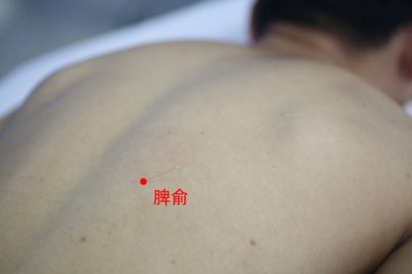
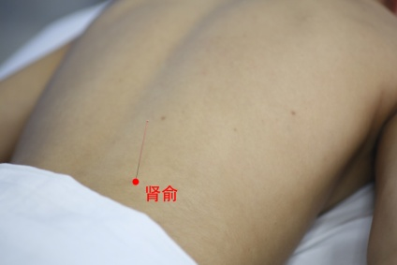
理论来源
Theoretical sources
脾俞：
在背部，第十一胸椎棘突下，旁开1.5寸
Pishu:
In the back, under the 11th thoracic spine, 1.5-inch side opening
肾俞：
在背部，第二腰椎棘突下，旁开1.5寸
Shenshu:
In the back, under the second lumbar spine, 1.5-inch side opening

Slide 72
理论来源
Theoretical sources
取穴含义：“补虚之功”
1.脾俞、肾俞是五脏六腑之气输注于背部的腧穴
2.二穴位置接近内脏，更容易调节脏腑的虚实
Meaning of acupoint selection: "the function of tonifying deficiency"
1.Pishu and Shenshu are acupoints for the gas of five zang organs and six Fu organs to be infused into the back.
2. The position of the two points is close to the internal organs, which is easier to regulate the deficiency and excess of the internal organs.

Slide 73
理论来源
Theoretical sources
取穴含义：“补虚之功”
3.脾俞健脾益气，肾俞补肾壮骨
4.脾有统血之功，针刺脾俞可活血通络，其法属阴
3. Spleen Shu, spleen and Qi, kidney Shu, kidney and bone.
4. The spleen has the function of regulating blood. Needling PI Shu can activate blood circulation and dredge collaterals, which belongs to Yin.

Slide 74
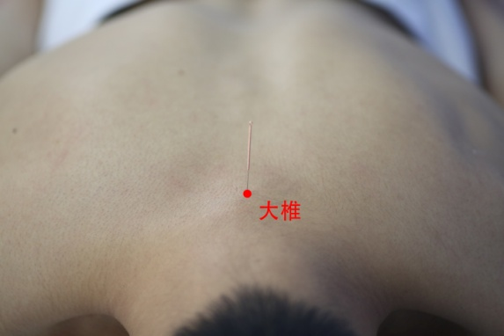
理论来源
Theoretical sources
大椎：
在背部，第七颈椎棘突下凹陷中
Dazhui:
In the back, in the depression of the seventh cervical spine.

Slide 75
理论来源
Theoretical sources
取穴含义：“化瘀之功”
1.大椎为督脉与三阳之会，通诸经之阳气，其法属阳
2.与脾俞肾俞阴阳相配，行气活血，体现了“化瘀”之功
Meaning of acupoint selection: "the function of removing blood stasis"
1. Dazhui is the meeting of Dumai and Sanyang, which is connected with the Yangqi of all scriptures. Its law is Yang. 2. Matching with the Yin and Yang of Pishu and Shenshu, promoting qi and promoting blood circulation, reflecting the function of "removing blood stasis".

Slide 76
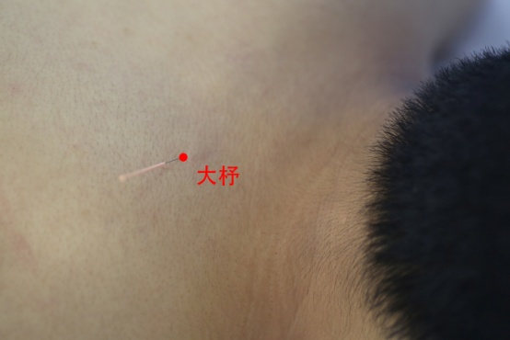
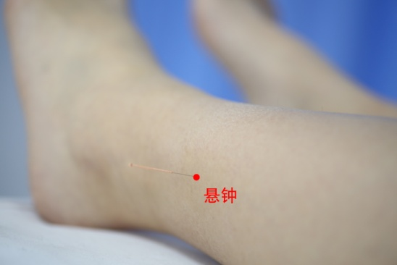
理论来源
Theoretical sources
大杼：
在背部，当第1胸椎棘突下，旁开1.5寸
Dazhu:
In the back, when the first thoracic spine is under the spinous process, the side opening is 1.5 inch.
悬钟：
外踝尖上3寸，腓骨前缘
Xuanzhong:
3 inches above the tip of the lateral malleolus, leading edge of fibula

Slide 77
理论来源
Theoretical sources
取穴含义：“上下取穴”
1.悬钟、大杼分别是髓会、骨会
2.二者一上一下，益髓壮骨，是治疗本病的重要配穴
Meaning of acupoint selection: "up and down acupoint selection"
1. Hanging bell and big loom are medullary meeting and bone meeting respectively.
2. One up and one down, benefiting the marrow and strengthening the bone, is an important point for the treatment of this disease.

Slide 78
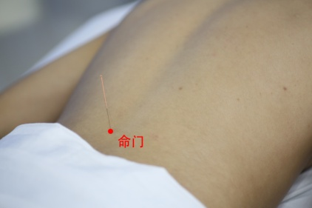
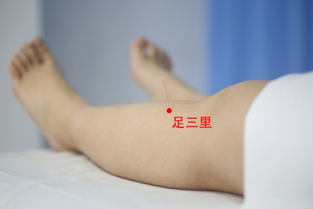
理论来源
Theoretical sources
命门：
在背部，位于第二、三腰椎棘突间
Mingmen:
In the back, between the spinous processes of the second and third lumbar vertebrae.
足三里：
在小腿前外侧,当犊鼻下3寸(即:外膝眼下四横指),距胫骨前缘一横指,胫骨前肌上
Zusanli:
On the anterolateral side of the leg, when the calf is 3 inches below the Dubi,A transverse finger from the anterior tibia, on the anterior tibial muscle

Slide 79
理论来源
Theoretical sources
取穴含义：“先天后天同补”
1.命门、足三里均为补益要穴
2.命门可补周身之元气，重在补益先天，足三里调理脾胃，益气固本，重在补益后天
3.先天后天同补相配，特别针对于本病多虚的致病特点，可增强本针法的补益作用
1. Mingmen and Zusanli are vital points for tonifying.
2. Mingmen can nourish the vitality of the whole body, focusing on nourishing the nature, regulating the spleen and stomach in Zusanli, nourishing the Qi and strengthening the foundation, and nourishing the day after tomorrow.
3. Congenitally acquired matching with tonic, especially for the pathogenic characteristics of multiple deficiency of this disease, can enhance the tonic effect of this acupuncture.

Slide 80
临床应用
Clinical Application

Slide 81
临床应用Clinical Application
消毒后选取脾俞穴直刺1寸，进针时针由浅入深，由左向右行捻转补法至局部产生酸、胀的针感。
肾俞穴直刺1寸，进针时针由浅入深，由左向右行捻转补法至局部产生酸、胀的针感。
After disinfection, the point of Pishu was directly pricked for 1 inch, and the needle was inserted from shallow to deep, from left to right by twirling, rotating and toning until the needle felt acid and swelling locally.
Shenshu Point is pricked 1 inch straight. When entering the needle, it turns from shallow to deep, and twists and turns from left to right to produce the needling sensation of acid and swelling locally.

Slide 82
临床应用Clinical Application
选取悬钟穴采用指切法直刺进针1寸，行捻转补法，由浅入深，至腧穴部产生沉紧、酸胀的针感，向足踝部放散。
选取大杼穴平刺进针0.5寸，行捻转补法，至腧穴部产生沉紧、酸胀的针感。
Select Xuanzhong acupoint to prick the needle 1 inch with finger cutting method, and then twist and rotate to supplement the needle. From the shallow to the deep, the needle will feel tight and acid swollen at the acupoint and release to the ankle.
Select Dazhu point to stab 0.5 inch into the needle, and then twist and rotate the needle until the acupoint feels tight and sore.

Slide 83
临床应用Clinical Application
选取大椎穴垂直进针1寸，采用提插补法，行针使患者产生局部产生酸、胀的针感，以达活血化瘀之效。
选取命门穴采用指切进针法，针尖斜向上约75度刺入，进针约1.5寸，行针至针下沉紧。
选取足三里穴采用直刺进针1寸，得气后由浅入深行捻转补法。
Select Dazhui point to enter the needle vertically for 1 inch, and use the method of lifting and interpolating to make the patient feel acid and distension locally, so as to achieve the effect of promoting blood circulation and removing blood stasis.
Select Mingmen point to use the method of finger cutting into the needle, the needle tip is inclined upward about 75 degrees, the needle is about 1.5 inches, and the needle moves until the needle sinks tight.
Select Zusanli acupoint adopts the method of direct needling and needling for 1 inch, and twirling and toning from shallow to deep after getting Qi.

Slide 84
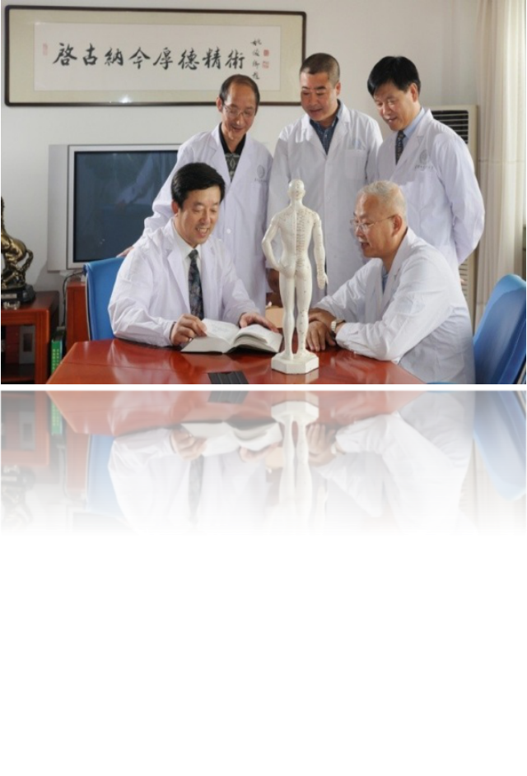
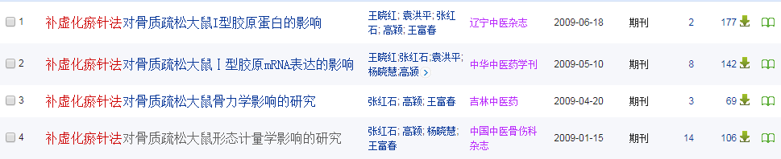
“补虚化瘀针法”选穴科学，疗效显著，自应用以来，为数以万计患者解除病痛，为临床指导提供可靠依据。
“acupuncture method of nourishing deficiency and removing blood stasis” Since its application, it has provided reliable basis for tens of thousands of patients to relieve their pain and clinical guidance.

Slide 85
病案分析
Case Analysis

Slide 86
病案分析 Case analysis
朱某，女，53岁，已婚。2013年9月03日初诊。
主诉：间断腰背痛3年。
现症：神智清楚，对答清晰，全身肌肉关节畏寒疼痛，面色滞暗，腰背疼痛向肋缘放射，口唇青紫，舌有瘀斑，脉沉迟涩。
Zhu, female, 53, married. First visit on September 3, 2013.
Chief complaint: intermittent back pain for 3 years.
History of present illness : clear mind, clear answers, chilly and painful muscles and joints, dark complexion, back pain radiating to costal margin, purple lips, ecchymosis on tongue, deep and astringent pulse.

Slide 87
病案分析 Case analysis
病史：2008年10月27日因摔倒而致右尺骨骨折，骨科处理。2011年1月19日再次骨折，骨科处理。2012年5月开始出现间断性腰背疼痛，2013年9月因腰背痛加重自行口服止痛药，效果不佳，遂来就诊。
检查：骨密度L1-4椎体T值-2.75SD，BMD749mg/厘米2，股骨颈T值-2.2SD，BMD602mg/厘米2。
Medical history: right ulna fracture due to fall on October 27, 2008, orthopaedic treatment. On January 19, 2011, the fracture was again treated by orthopedics department. In May 2012, intermittent back pain began to appear. In September 2013, due to the aggravation of back pain, self-administered painkillers had poor effect, so they came to see a doctor.
Examination: Bone mineral density l1-4 vertebral body t-value-2.75sd, bmd749mg / cm2, t value of femoral neck was -2.2sd, bmd602mg / cm2.

Slide 88
病案分析 Case analysis
诊断：
西医诊断：骨质疏松症。
中医诊断：骨痿（肾寒血瘀）。
Diagnosis:
Western medicine diagnosis: osteoporosis.
Traditional Chinese medicine diagnosis: osteoasthenia (kidney cold and blood stasis).

Slide 89
病案分析 Case analysis
治疗：
治法：补虚化瘀、温肾暖脾。
取穴：大椎、大杼（双）、脾俞（双）、肾俞（双）、命门、足三里（双）、绝骨（双）
操作：大椎、大杼、脾俞、肾俞斜刺0.5寸；命门直刺1寸；足三里直刺1.5寸；绝骨直刺1.5寸。针用补法，每次留针30分钟，每日针1次
Treatment:
Treatment plan: tonifying deficiency and removing stasis, warming kidney and warming spleen.
Acupoints selection: Dazhui, Dazhu (Shuang), Pishu (Shuang), Shenshu (Shuang), Mingmen, Zusanli (Shuang), juegu (Shuang)
Operation: Dazhui, Dazhu, Pishu, Shenshu oblique needling 0.5 inch; Mingmen straight needling 1 inch; Zusanli straight needling 1.5 inch; jueju straight needling 1.5 inch. Acupuncture with tonic method, 30 minutes each time, once a day.

Slide 90
病案分析 Case analysis
疗程：
针刺10次为1个疗程，治疗6次后腰背痛的情况明显改善，3个疗程后痊愈，半年后随访未见复发。
Course of treatment:
Acupuncture 10 times for a course of treatment,after 6 times of acupuncture, the condition of lumbago and back pain was improved obviously. After 3 courses of acupuncture, it was cured, and no recurrence was found in half a year follow-up.

Slide 91
医案解读
Interpretation of medical records
“补虚化瘀”针法遵循了补化兼施、标本兼顾的原则，包括了阴阳配穴、上下配穴、先后天配穴的多种配穴方法。达到了补肾壮骨，健脾益气，活血通络的功效，有效的缓解了骨质疏松状态。此治则充分体现了中医理论中治病求本，标本兼治的原则。
The acupuncture method of "acupuncture method of nourishing deficiency and removing blood stasis" follows the principle of both invigorating and transforming, and taking into account both the specimen and the specimen. It includes various acupoint matching methods of yin and Yang, upper and lower acupoints, and Tianpei acupoints successively. It has achieved the effect of Tonifying the kidney and strengthening the bones, strengthening the spleen and Qi, promoting blood circulation and unblocking collaterals, and effectively alleviated the state of osteoporosis. This principle fully embodies the principle of seeking the root and treating both the symptoms and the symptoms in the theory of traditional Chinese medicine.

Slide 92
感谢！
Thank you.

